Slide 1

ICT502
Week 6: Project Implementation
ICT502 Applied IT Project A
1

Slide 2
What we learned last week
IT Industry Needs and Trends
Identifying key skills and capabilities required in IT Projects
Tools and technologies for developing sustainable solutions
Interpreting patents and identifying prior art

Slide 3
Week 6 Overview
From Ideas to Real Project Implementation
This week students learn:
How IT projects move from planning to implementation
How to communicate professionally with a client
How to identify real business problems
How to propose realistic IT solutions
How to connect company information to Assessment 4

Slide 4
Assessment 4 Mindset
Important Shift in Assessment 4
Assessment 3:
Understanding the company
Asking questions
Research and reflection

Slide 5
Assessment 4 Mindset
Assessment 4:
Designing a solution
Explaining implementation
Managing risks and communication
Creating technical documentation
Students are now acting like:
IT consultants
Business analysts
Project coordinators

Slide 6
What Students Should Understand About NSW IT Support
NSW IT Support Main Business Areas
Services:
Managed IT support
Cloud services
Cybersecurity
Telecommunications
Web development

Slide 7
What Students Should Understand About NSW IT Support
Common Client Needs:
Fast issue resolution
Secure systems
Reliable cloud services
Remote support
Business continuity

Slide 8
What Students Should Understand About NSW IT Support
Common Challenges:
High number of support tickets
Cybersecurity risks
Client communication
Different client requirements
Managing many projects simultaneously

Slide 9
How Students Can Find Project Problems
Students Should Think:
What business problem can technology improve?
Example Problems:
Problem | Possible Solution
Slow ticket response | AI ticketing system
Cybersecurity threats | Security monitoring dashboard
Poor communication | Client portal/chatbot
Manual processes | Workflow automation
Data management issues | Cloud database solution

Slide 10
How Students Can Find Project Problems
Assessment 4 is NOT just theory. Students should solve a realistic business problem.

Slide 11
Questions Students Can Ask NSW IT Support
Understanding Business Problems
Good Questions:
What are the most common IT problems your clients face?
Which tasks take the most time?
What causes delays in support?
What challenges do SMEs usually have with IT?
What security risks do clients worry about most?
Which services are growing the fastest?

Slide 12
Questions Students Can Ask NSW IT Support
Why These Questions Matter:
These answers help students:
define the problem,
justify the solution,
and write stronger Assessment 4 reports.

Slide 13
Questions About Project Implementation
Questions Related to Week 6 Topic
Implementation Planning
How do you plan a new IT project?
How do you estimate time and cost?
How do you prioritise tasks?

Slide 14
Questions About Project Implementation
Project Execution
How do teams coordinate during implementation?
What tools do you use to track progress?
Monitoring & Control
How do you know if a project is successful?
How do you manage unexpected problems?

Slide 15
Questions About Project Implementation
Closing Projects
How do you gather client feedback after project completion?
Do you provide ongoing support?

Slide 16
Helping Students Think Like Consultants
Instead of Asking Only:
“What technology do you use?”
Students Should Also Ask:
Why was this technology chosen?
What business problem does it solve?
Was there a cheaper or simpler option?
What risks were considered?
How does it improve customer experience?
This shows critical thinking.

Slide 17
Example: Turning Company Problems Into Assessment 4 Solutions
Example 1
Problem:
Clients submit too many repetitive support requests.
Proposed Solution:
AI chatbot + ticket classification system
Assessment 4 Sections:
Functional requirements
Sustainability
AI integration
Communication plan

Slide 18
Example: Turning Company Problems Into Assessment 4 Solutions
Example 2
Problem:
Clients worry about cyber attacks.
Proposed Solution:
Cybersecurity monitoring dashboard
Assessment 4 Sections:
Security design
Risk management
Ethical considerations

Slide 19
Sustainability Ideas (Very Important)
Students MUST Include Sustainability
Environmental:
Cloud systems reduce hardware waste
Economic:
Automation reduces operational costs
Social:
Accessible systems improve customer experience
Students often forget this section.

Slide 20
Common Mistakes in Assessment 4
X Solution too general X No real business problem X No implementation discussion X No diagrams/models X Weak communication strategy X No sustainability discussion X No justification for technology choices

Slide 21
Simple Assessment 4 Structure
Students Should Clearly Explain:
1. Problem
What is the issue?
2. Solution
What system/tool solves it?
3. Technology
Why these technologies?

Slide 22
Simple Assessment 4 Structure
4. Implementation
How will it be developed and deployed?
5. Risks & Ethics
What could go wrong?
6. Communication
How will stakeholders stay informed?
7. Future Development
How can the project improve later?

Slide 23
Final Advice to Students
Best Assessment 4 Reports:
✔ solve real business problems ✔ use realistic technologies ✔ explain implementation clearly ✔ communicate professionally ✔ connect technical + business thinking
Think like an IT consultant, not just a student.

Slide 24
Week 6 Pre-Class Readings
YouTube Video:
The Project Implementation Plan:
https://www.youtube.com/watch?v=FbbeCcBRYkY

Slide 25
Week 6 Pre-Class Readings
Key Messages from the Video: What is a Project Implementation Plan (PIP)?
A Project Implementation Plan (PIP) is a detailed guide that explains:
What needs to be done in a project
Who will do the work
When tasks should be completed
How the project success will be measured
It helps project managers and teams stay organized and complete projects successfully.

Slide 26
Week 6 Pre-Class Readings
Main Components of a Project Implementation Plan
1. Project Goals and Objectives
Goal = the main result the project wants to achieve
Objectives = smaller steps or milestones to reach the goal
Example:
Goal: Create a shopping app
Objectives:
Design the app
Test the app
Launch the app

Slide 27
Week 6 Pre-Class Readings
2. Success Criteria
This explains how the team will know the project is successful.
The project manager and stakeholders should agree on:
What success looks like
How to measure success
Example:
Sell 20,000 bottles in one quarter
Reach 1,000 households with clean water

Slide 28
Week 6 Pre-Class Readings
3. Scope Statement
This explains:
What work will be done
Where the project will happen
Who will benefit
The project timeline
Example:
Target customers
Project location
Time frame

Slide 29
Week 6 Pre-Class Readings
4. Resource Plan
This lists all resources needed for the project.
Resources may include:
Workers
Equipment
Materials
Money
Partners

Slide 30
Week 6 Pre-Class Readings
Example:
Engineers
Construction materials
Software developers

Slide 31
Week 6 Pre-Class Readings
5. Risk Analysis
Projects can face problems or risks.
The team should:
Identify possible risks
Prepare backup plans (contingency plans)

Slide 32
Week 6 Pre-Class Readings
Example Risks:
Machine breakdown
Lack of support
Delays
Tool Mentioned:
SWOT Analysis
Strengths
Weaknesses
Opportunities
Threats

Slide 33
Week 6 Pre-Class Readings
6. Implementation Timeline
This shows:
When tasks should start
When tasks should finish
Deadlines help the team stay on schedule.
7. Milestones
Milestones are important achievements during the project.
They help the team:
Track progress
Check if objectives are being achieved
Example:
Finish app design
Complete testing phase

Slide 34
Week 6 Pre-Class Readings
8. Roles and Responsibilities
Each team member should know:
Their task
Their deadline
Tasks should match team members’ skills and strengths.
Important Steps to Create a PIP
Step 1: Conduct Research
Research helps understand:
Project goals
Budget
Timeline
Past project experiences

Slide 35
Week 6 Pre-Class Readings
The team may talk to:
Stakeholders
Customers
Partners
Step 2: Set SMART Goals
Goals should be:
Specific
Measurable
Attainable
Realistic
Time-bound

Slide 36
Week 6 Pre-Class Readings
Example:
“Produce 20,000 bottles in 3 months.”
Step 3: Identify Risks
Think about possible problems before they happen.
Then prepare solutions or backup plans.
Step 4: Assign Tasks
The manager should:
Divide the work
Give tasks to suitable team members

Slide 37
Week 6 Pre-Class Readings
Step 5: Prioritize Tasks
Do the most important and urgent tasks first.
Example:
In construction:
Build foundation
Build walls
Add roof

Slide 38
Week 6 Pre-Class Readings
Step 6: Set Timelines
Every task should have a deadline.
This improves:
Productivity
Time management
Team accountability

Slide 39
Week 6 Pre-Class Readings
Step 7: Identify Necessary Resources
Make sure the project has:
Enough materials
Enough workers
Enough support partners
Step 8: Evaluate Project Success
Check regularly:
Is the project meeting objectives?
Are customers satisfied?
Does the strategy need improvement?

Slide 40
Week 6 Pre-Class Readings
Simple Overall Summary
A Project Implementation Plan helps teams:
Organize work
Set goals
Manage time
Use resources properly
Reduce risks
Track progress
Achieve project success
It is an important tool for successful project management.

Slide 41
Week 6 Pre-Class Readings
Discussion Questions
Question 1
What is a Project Implementation Plan (PIP)?
A PIP is a detailed guide that explains how a project will be completed.
Question 2
Why is a Project Implementation Plan important?
It helps the team stay organized, manage time, reduce risks, and achieve project goals

Slide 42
Week 6 Pre-Class Readings
Question 3
What is the difference between a goal and an objective?
A goal is the main result of the project, while objectives are smaller steps used to achieve the goal.
Question 4
What does SMART mean in project planning?
SMART means:
Specific
Measurable
Attainable
Realistic
Time-bound

Slide 43
Week 6 Pre-Class Readings
Question 5
Why is risk analysis important?
It helps the team prepare for possible problems before they happen.
Question 6
What are project resources?
Resources are the people, materials, equipment, money, and tools needed for the project.

Slide 44
Week 6 Pre-Class Readings
Question 7
What is a milestone in a project?
A milestone is an important achievement or stage in the project.
Question 8
Why should tasks have deadlines?
Deadlines help the team finish work on time and stay productive.

Slide 45
Week 6 Pre-Class Readings
Question 9
Why should tasks be assigned based on skills?
People work better and faster when tasks match their skills and strengths.
Question 10
How do teams know if a project is successful?
They compare the project results with the goals and success criteria set at the beginning.

Slide 46
Week 6 Topics
Introduction to Project Implementation
Developing an Implementation Plan
Project Execution
Project Monitoring and Controlling
Closing the Project

Slide 47
Pre-Class Discussion
Please review this video I will ask you questions.
How to Successfully Execute a Plan?
Youtube:
https://www.youtube.com/watch?v=802yQd8TNf8

Slide 48
Pre-Class Discussion
Question 1
What are the four main steps shown in the video?
The four main steps are:
Plan
Execute
Monitor
Control
Question 2
What does “execute a plan” mean?
It means carrying out or doing the planned tasks and activities.

Slide 49
Pre-Class Discussion
Question 3
Why is planning important before execution?
Planning helps people understand:
What to do
Who will do it
When it should be done
How to achieve success

Slide 50
Pre-Class Discussion
Question 4
What happens during the execution stage?
During execution, the team:
Performs the tasks
Produces results
Works toward project goals

Slide 51
Pre-Class Discussion
Question 5
Why is communication important during execution?
Communication helps team members:
Share updates
Discuss problems
Report risks and changes
Work together effectively

Slide 52
Pre-Class Discussion
Question 6
What does monitoring a plan mean?
Monitoring means checking whether the project is going according to plan.
Question 7
What should a project manager monitor?
A project manager should monitor:
Progress
Schedule
Costs
Resources
Risks

Slide 53
Pre-Class Discussion
Question 8
What is the purpose of controlling a plan?
Controlling helps fix problems and keep the project on track.
Question 9
What can happen if a project is not monitored?
The project may:
Fall behind schedule
Waste money
Miss goals
Face bigger problems later

Slide 54
Pre-Class Discussion
Question 10
Why are timelines important in a project?
Timelines help people finish tasks on time and avoid delays.
Question 11
What are project resources?
Resources are things needed to complete the project, such as:
People
Equipment
Materials
Money

Slide 55
Pre-Class Discussion
Question 12
Why should tasks be assigned to the right people?
People work better when tasks match their skills and experience.
Question 13
What should a team do if the project is not going well?
The team should:
Review the problem
Make adjustments
Improve the plan
Take corrective action

Slide 56
Pre-Class Discussion
Question 14
Why is regular updating important in project execution?
Regular updates help everyone know:
Current progress
Problems
Changes
Next steps

Slide 57
Pre-Class Discussion
Question 15
What is one important lesson from the video?
A successful project needs:
Good planning
Clear communication
Monitoring
Control
Teamwork

Slide 58
Pre-Class Discussion
Short Classroom Discussion Activities
Activity 1
Can a project succeed without planning? Why or why not?
No, because without planning people may not know their tasks, deadlines, or goals.

Slide 59
Pre-Class Discussion
Activity 2
What problems can happen during project execution?
Problems may include:
Delays
Lack of resources
Poor communication
Budget problems
Team conflicts

Slide 60
Pre-Class Discussion
Activity 3
Why is teamwork important in executing a plan?
Teamwork helps people share responsibilities, solve problems together, and complete work faster.

Slide 61
Pre-Class Discussion
Activity 4
What should managers do when a project goes off track?
Managers should monitor the project, identify problems, and make corrections quickly.

Slide 62
Pre-Class Discussion
Activity 5
Which step do you think is most important: Plan, Execute, Monitor, or Control? Why?
Planning is important because it guides all the other steps. Without a good plan, execution becomes difficult.

Slide 63
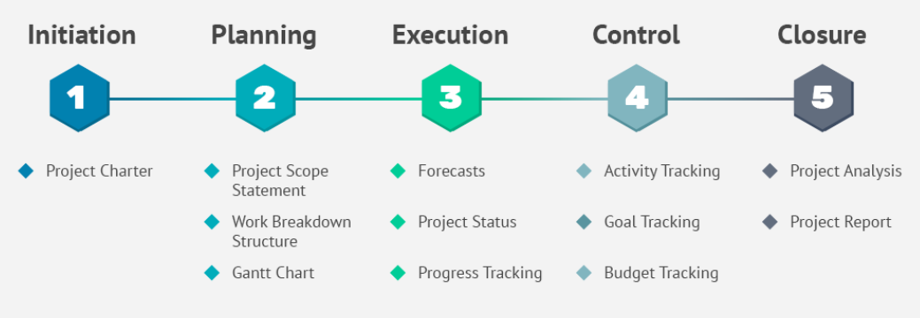
The 5 Phases of The Project Life Cycle

Slide 64
Introduction to Project Implementation
Key Objectives of Project Implementation
Achieve project deliverables: Ensure all planned outputs are produced.
Meet deadlines and stay within budget: Adherence to project timeline and financial constraints.
Ensure quality standards: Deliver outcomes meeting stakeholder expectations.

Slide 65
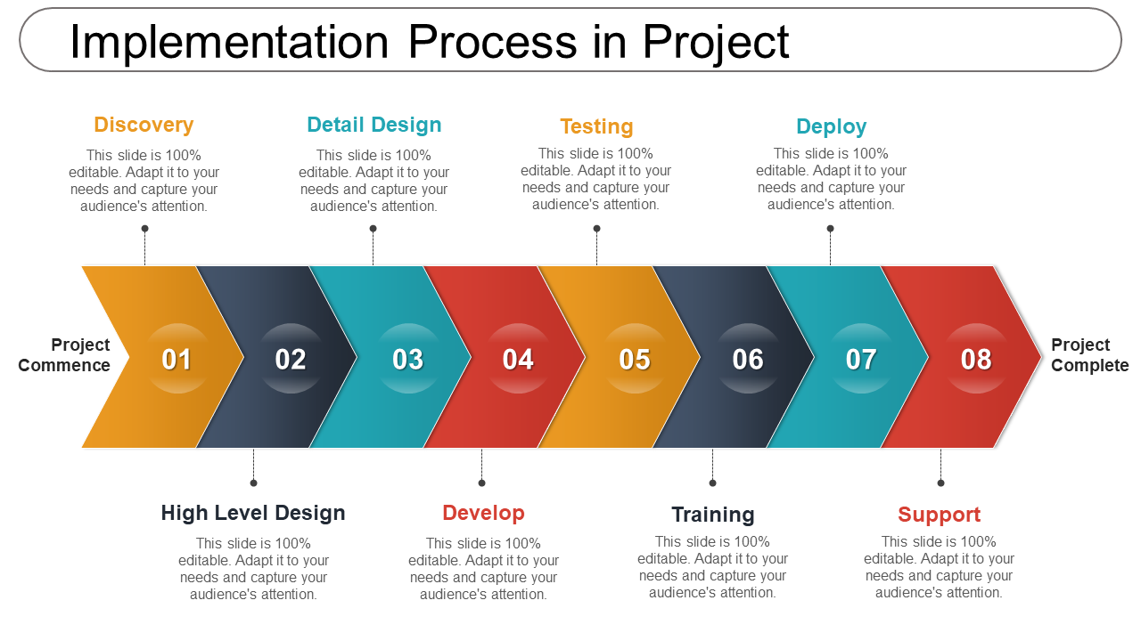
Introduction to Project Implementation (cont.)

Slide 66
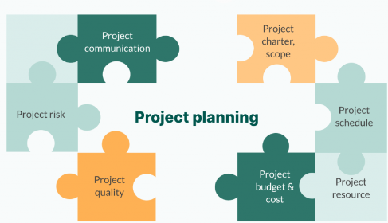
Developing an Implementation Plan
Project implementation plan
A project implementation plan serves as a roadmap that outlines the steps and processes required to execute a project successfully. It keeps the team aligned, increases efficiency, communication, and effective resource use, and saves projects from risks like scope creep.

Slide 67
Developing an Implementation Plan (cont.)
Components of an Implementation Plan
Scope and Objectives: Clearly define project boundaries and desired outcomes.
Tasks: Breakdown of work into manageable activities.
Resources: Allocation of human, financial, and technological resources.
Timeline: Schedule of tasks and milestones.
Risks: Identification and mitigation strategies.
Quality Assurance: Criteria and benchmarks for ensuring deliverable quality.

Slide 68
Developing an Implementation Plan (cont.)
Steps to Create an Implementation Plan
Gathering Requirements: Elicit and document stakeholder needs and expectations.
Defining Tasks: Creating a Work Breakdown Structure (WBS) to organise and schedule tasks.
Allocating Resources: Assigning resources based on availability and skillset.
Setting Timelines: Establishing realistic deadlines and milestones for each task.

Slide 69
Developing an Implementation Plan (cont.)
Introduction to Scheduling Techniques
Purpose:
Ensure tasks are completed on time within the project timeline.
Tools:
Gantt Charts: Visual representation of tasks and timelines.
PERT Charts: Analysis of task dependencies and critical paths.
Critical Path Method (CPM): Identifying longest sequences of tasks determining project duration.

Slide 70
Developing an Implementation Plan (cont.)
Identifying and Allocating Resources
Purpose:
Ensure tasks are completed on time within the project timeline.
Types of Resources:
Human Resources: Skill sets and roles required for project execution.
Financial Resources: Budget allocation and cost management.
Technological Resources: Tools and equipment necessary for project tasks.

Slide 71
Developing an Implementation Plan (cont.)
Budget Management
Benefits:
Financial Control: Preventing budget overruns and ensuring financial stability.
Project Viability: Assessing financial feasibility and sustainability throughout the project lifecycle.
Creating a Budget:
Cost Estimation: Estimating expenses for project tasks and resources.
Budget Tracking: Monitoring actual expenditures against budgeted amounts.
Example: Using budget management tools to track project finances accurately.

Slide 72
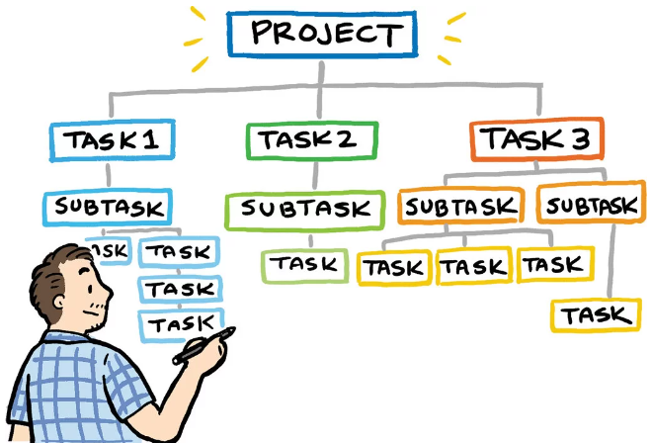
Developing an Implementation Plan (cont.)
Assigning Tasks
Matching Skills: Assigning tasks based on team member expertise and capabilities.
Responsibility Assignment Matrix (RAM): Defining roles and responsibilities for each project task.

Slide 73
Developing an Implementation Plan (cont.)
Monitoring Tools:
Project Management Software: Tools like Jira, Trello, or Microsoft Project for task tracking and progress monitoring.
Key Performance Indicators (KPIs): Metrics used to measure project performance against objectives.
Example: Using KPIs to track project milestones and performance indicators effectively.

Slide 74
Developing an Implementation Plan (cont.)
Identifying Risks in IT Projects
Common Risks:
Technical Risks: Challenges related to technology integration or system failures.
Financial Risks: Budget overruns or unexpected costs impacting project finances.
Operational Risks: Process inefficiencies or organisational changes affecting project execution.

Slide 75
Developing an Implementation Plan (cont.)
Developing Risk Mitigation Plans
Mitigation Strategies:
Risk Avoidance: Proactively avoiding risks by adjusting project plans or strategies.
Risk Transfer: Transferring risk to third parties through contracts or insurance.
Risk Mitigation: Implementing actions to reduce the likelihood or impact of identified risks.

Slide 76
Developing an Implementation Plan (cont.)
Communication Plans:
Identifying project stakeholders, defining communication channels, and establishing
Tools for Communication
Slack: Real-time messaging and collaboration platform for project teams.
Microsoft Teams: Integrated communication and collaboration hub for remote and distributed teams.
…

Slide 77
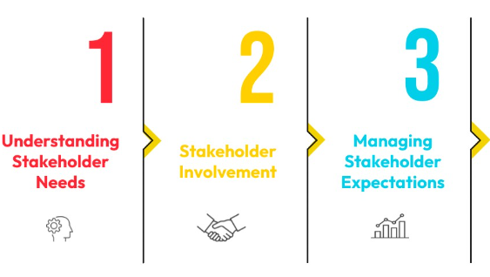
Developing an Implementation Plan (cont.)
Stakeholder Engagement Planning
Identifying Stakeholders: Mapping stakeholders based on their influence and interest in the project.
Engagement Strategies: Involving stakeholders in decision-making, providing updates, and gathering feedback.

Slide 78
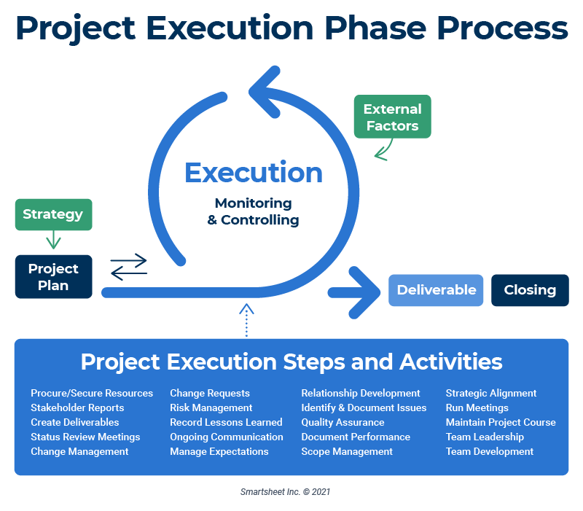
Project Execution

Slide 79
Project Execution (cont.)
Activities during the project execution phase include the following:
People management
Ongoing communication
Delivering project goals
Reducing scope creep
Monitoring quality
Resource allocation
Schedule management

Slide 80
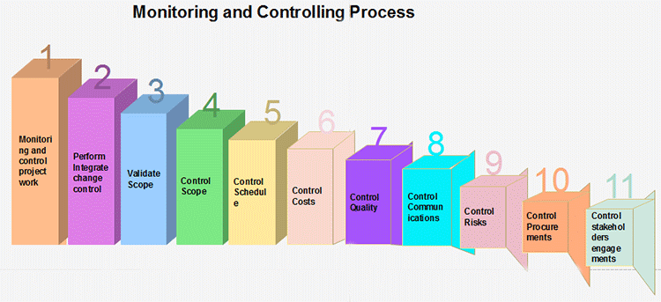
Project Monitoring and Controlling
Monitoring and Controlling are processes needed to track, review, and regulate the progress and performance of the project. It also identifies any areas where changes to the project management method are required and initiates the required changes.

Slide 81
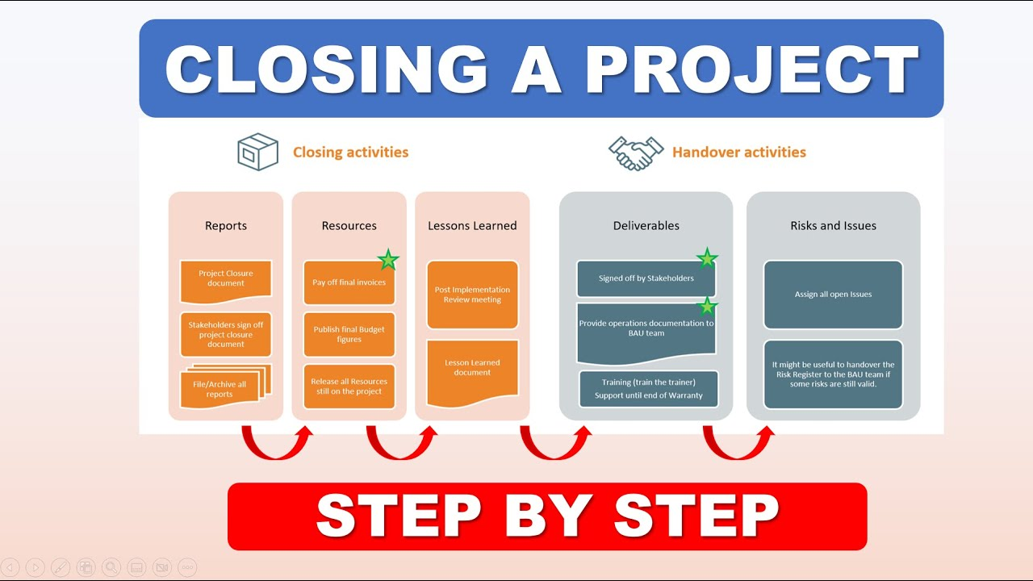
Closing the Project

Slide 82
Group Discussion Case Study
Scenario: Software Development Project Implementation
You are leading a team in developing a new mobile application for a client. The project involves creating an app that allows users to track their fitness activities and nutrition intake.
Questions:
What are the initial steps you would take to kick off this software development project?
How would you allocate tasks among your team members?
What strategies would you implement to ensure the quality of the mobile app meets client expectations?

Slide 83
Case Study: Discussion Points
What are the initial steps you would take to kick off this software development project?
Review client requirements and project scope.
Conduct stakeholder meetings to align expectations.
Define project objectives and deliverables.
How would you allocate tasks among your team members?
Assess team members' skills and assign tasks accordingly.
Use project management tools to track task assignments and progress.
Schedule regular team meetings for updates and collaboration.
What strategies would you implement to ensure the quality of the mobile app meets client expectations?
Establish quality standards and testing protocols.
Conduct regular quality assurance checks throughout development phases.
Gather feedback from beta testers and stakeholders for iterative improvements.

Slide 84
Summary
Initiate projects with well-defined objectives and stakeholder alignment to set the foundation for success.
Allocate tasks efficiently, monitor progress rigorously, and ensure adherence to timelines for timely project completion.
Implement rigorous quality control measures to maintain high standards and meet client expectations.
Manage budgets prudently to control costs and avoid financial overruns during project execution.
Utilise robust change management processes to handle project modifications effectively and maintain project momentum.
Document lessons learned to refine project execution practices and enhance future project outcomes.

Slide 85
Q&A
Question?

Slide 86
Week 6 Workshop :
Project Implementation
ICT502
ICT502 Applied IT Project A
86

Slide 87

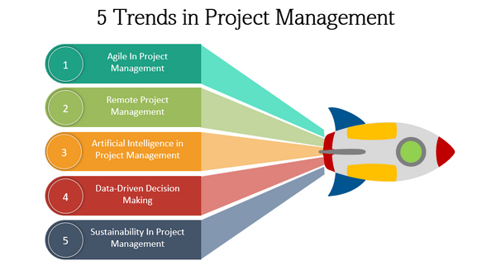
5 Project Management Trends

Slide 88
5 Project Management Trends
Trend #1: Agile in Project Management
Overview: Agile methodologies enable adaptive project management by breaking down work into smaller, manageable increments called sprints. This iterative approach enhances flexibility, responsiveness, and stakeholder engagement, ensuring projects align with evolving business needs.
Key Points:
Cross-functional teamwork and collaboration
Ownership, accountability, and collective success
Demand for Agile skills (Scrum, Kanban)

Slide 89
5 Project Management Trends
Trend #2: Remote Project Management
Overview: Embracing remote work allows organisations to access a global talent pool, fostering diversity and innovation. Effective remote project management requires strong leadership, clear communication, and community-building efforts to support geographically dispersed teams.
Key Points:
Benefits of global talent acquisition
Leadership and interpersonal skills for remote team success
Trust-building and virtual collaboration strategies

Slide 90
5 Project Management Trends
Trend #3: Artificial Intelligence in Project Management
Overview: AI enhances project management through data-driven insights, automating repetitive tasks, and predictive analytics. It optimises decision-making, risk management, and resource allocation, improving efficiency and reducing errors.
Key Points:
Data analysis for insights and predictions
Automation of project management tasks
AI-powered tools for scheduling, budgeting, and progress tracking

Slide 91
5 Project Management Trends
Trend #4: Data-Driven Decision Making
Overview: Leveraging data to make informed decisions increases project accuracy and minimises risks. AI-powered analytics facilitate real-time data processing, enabling proactive decision-making and enhancing overall project outcomes.
Key Points:
Cultivating a data-driven mindset
Automation of data analysis processes
Reliable data sources for informed decision-making

Slide 92
5 Project Management Trends
Trend #5: Sustainability in Project Management
Overview: Integrating eco-conscious practices, social responsibility, and economic viability into projects ensures long-term positive impacts. Sustainability involves adopting green technologies, minimising waste, and engaging stakeholders to promote environmental, social, and economic well-being.
Key Points:
Eco-conscious project practices
Social responsibility and community engagement
Economic viability and long-term financial implications

Slide 93
Video: The Future of Project Management
The Future of Project Management: Trends to Watch
Watch this video to learn :
https://www.youtube.com/watch?v=6N_0uc6KctE

Slide 94
Workshop Activity 1
Scenario 1: Agile in Project Management
Scenario: You are leading a software development project for a healthcare startup. The project involves creating a patient management system that needs to adapt to evolving regulatory requirements and user feedback.
Discuss in your groups:
How can Agile methodologies help in managing the dynamic regulatory landscape and user requirements in this healthcare project?
What role does cross-functional collaboration play in ensuring the success of Agile projects like this healthcare software development?

Slide 95
Workshop Activity 2
Scenario 2: Artificial Intelligence in Project Management
Scenario: You are implementing an AI-driven predictive analytics project for a retail chain to optimise inventory management and supply chain logistics.
Discuss in your groups:
How can AI-powered predictive analytics improve inventory forecasting and supply chain efficiency in this retail project?
How can AI-powered predictive analytics help retailers personalise customer experiences and enhance customer satisfaction?

Slide 96
Workshop Activity 3: Open Questions
Discuss in your group with the help of an online search platform:
How can Agile methodologies accommodate changes in project scope and requirements effectively?
What are the challenges of transitioning from traditional project management to Agile, and how can they be overcome?
How can remote project managers ensure alignment between team members located in different time zones?
How can AI-powered predictive analytics improve project forecasting and risk management?
What ethical implications should project managers consider when integrating AI into project management processes?
How does sustainability contribute to long-term project viability and resilience?

Slide 97
Workshop Activity 4: Infographic summary
◆ Students are required to list the concepts that have been covered in the reading materials and lecture and group them by their category.
◆ Use an online tool (such as https://www.canva.com/ ) to produce the infographic summary to be submitted and present to the class.

